Slide 1
Relationships in ERNs
Key Concepts:
Handling M:N Relationships
Composite (Associative or Bridge) Entities
Handling 1:M Relationships
Many entity gets FK linking back to 1 entity,
Connectivity & Cardinality
Relationship Participation
Optional & Mandatory Relationships
Multi-valued Attributes
Relationship Degree
Unary, Binary & Ternary Relationships
Recursive Relationships

Slide 2
Relationships
Relationships are associations between entities, always operating in both directions.
Relationship classification may be difficult to establish if only one side of the relationship is known.
E.g. A division is managed by one employee.
If this is all that is known, it could by 1:M or 1:1.
Need to know whether
one employee can manage more than one division.
There can be more than one relationship between the same pair of entities.

Slide 3
Relationship Implementation
A 1:M relationship is implemented by the primary key of the "one" entity appearing as a foreign key in the “many” entity's table.
A 1:1 relationship is handled similarly, but either table can be chosen to place the foreign key in.
A M:N relationship is handled by splitting it into multiple 1:M relationships.

Slide 4
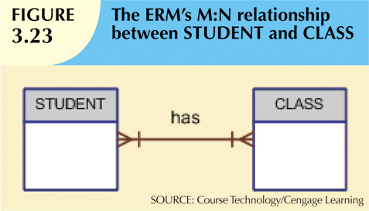
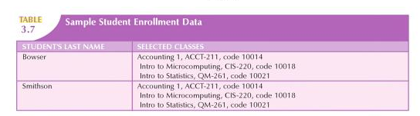
M:N Example
A student may enroll in many classes; A class may have many students.

Slide 5
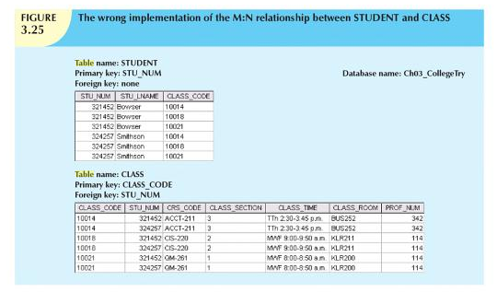
Handling M:N Relationships – Wrong!
Don't put a FK in one table to point to the other. This creates many data redundancies.

Slide 6
Handling M:N Relationships
Create a composite entity (also called a bridge entity or associative entity).
The corresponding table is called a linking table because it links the 2 entities.
Include as FKs the PKs of the two tables.
Its PK is either:
A combination of these FKs
OR
A newly created PK.
Note: A bridge entity may not have any other attributes.
Though it often will have attributes of its own.
The M:N relationship is converted into two 1:M relationships.

Slide 7

Composite Entity - Example
Note how the many-to-many relationship has become
TWO one-to-many relationships.
NOTE: It is NOT necessary describe to describe the relationships between the bridge entity and the entities being bridged in detail in the business rules.

Slide 8
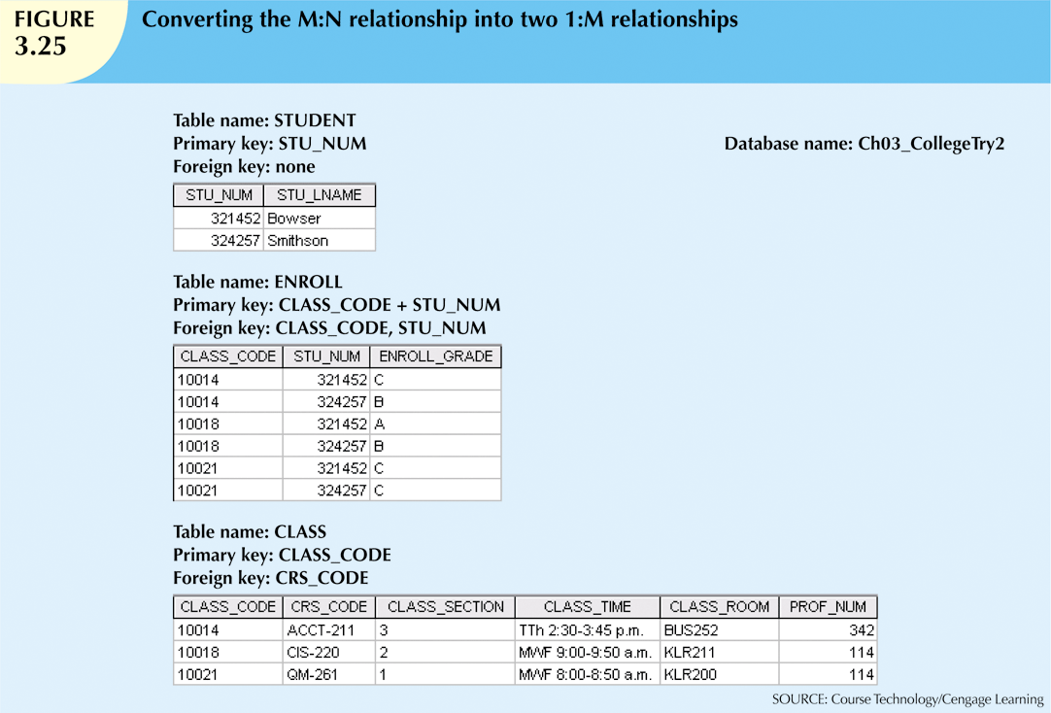
Composite Entity – Example Data
Could have created a new PK called, say, ENROLL_LINE,
using a different line value to identify each row in ENROLL table.
ENROLL table has other attributes as well e.g. grade.

Slide 9
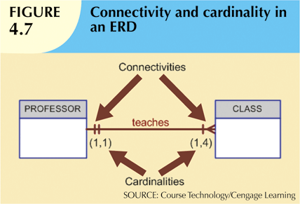
Connectivity and Cardinality
Connectivity
Describes the relationship classification (1:1, 1:M, or M:N).
Cardinality
Expresses the minimum and maximum number of entity occurrences associated with one occurrence of related entity.
The (1, 4) means each professor teaches at
least 1 and not more than 4 classes;
i.e. each PK in the PROFESSOR table occurs
at least once but not more than 4 times as a
FK in the CLASS table.

Slide 10
Relationship Participation
Optional participation
One entity occurrence does NOT require a corresponding related entity occurrence.
Minimum cardinality is 0.
E.g. "COURSE generates CLASS".
An entity in the COURSE table does not have to have a corresponding entity in the CLASS table.
Mandatory participation
One entity occurrence requires a corresponding entity occurrence in the the relationship.
Cardinality is at least 1.
E.g “CHILD has PARENT”.
BOTH ends of a relationship need to have the participation specified.

Slide 11
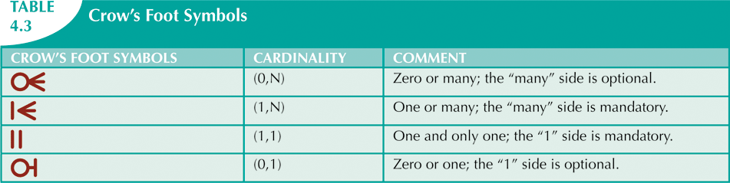
Crow’s Foot Symbols
Do NOT write that a relationship is 0-Many.
Write that it is 1-Many, optional at the many-end.

Slide 12
Participation and Referential Integrity
Participation can sometimes be confused with referential integrity.
E.g. consider the "married" relationship among employees.
Participation asks these questions:
Must every employee have a spouse who is also an employee?
Must every employee be a spouse to another employee?
The answer to both is "No", so the relationship is optional at both ends.
Referential integrity addresses the question of whether every foreign key reference refers to a valid value in the other table's primary key. It asks the question:
Must every employee's spouse who is also an employee be a valid employee?
The answer is "Yes".

Slide 13
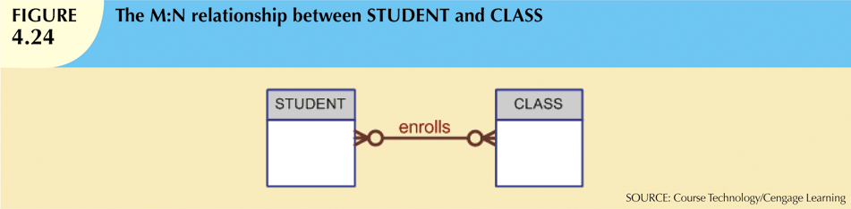
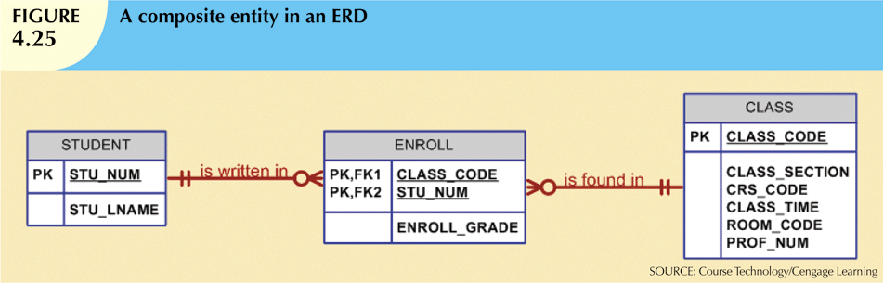
Participation in M:N Relationships
When converting an M:N relationship into two 1:M relationships,
make sure to transfer the participation.

Slide 14
Multivalued Attributes
Single-valued attributes can have only one value for each entity instance.
E.g. SSN, age.
Multivalued attributes can have many values for some entity instances.
E.g. college degree (someone can have more than one degree).
E.g. car color (top, trim, body).
Multivalued attributes are a potential problem for the relational model, because the intersection of each row and column should contain “one value” only.
CAR_VIN | MODEL_CODE | CAR_YEAR | CAR_COLOR
1M8GDM9A | TYT | 2006 | Top-White, Trim-Gold, Body-Blue
3T671ATTB | HND | 2011 | Top-Red, Trim-Blue, Body-Black
….

Slide 15
Dealing with Multivalued Attributes
There are 2 ways to deal with multi-valued attributes:
Create new attributes.
Create a new entity.
(1) Create several new attributes; E.g. CAR_TOPCOLOR, CAR_TRIMCOLOR, CAR_BODYCOLOR.
Problem: This may create many nulls.
E.g. In the degree example, would need to create attributes for UndergradDegree, MastersDegree, PhD, most of which would be NULL for many people.
CAR_VIN | MODEL_CODE | CAR_YEAR | CAR_TOPCOLOR | CAR_TRIMCOLOR | CAR_BODYCOLOR
1M8GDM9A | TYT | 2006 | White | Gold | Blue
3T671ATTB | HND | 2011 | Red | Blue | Black
….

Slide 16
Dealing with Multivalued Attributes
(2) Create a new entity to store the original attribute's different values; relate new entity to original one using a 1:M relationship.
CAR Table
CAR_VIN | MODEL_CODE | CAR_YEAR
1M8GDM9A | TYT | 2006
3T671ATTB | HND | 2011
….
CAR_COLOR Table
CAR_VIN | COL_SECTION | COL_COLOR
1M8GDM9A | Top | White
1M8GDM9A | Trim | Gold
1M8GDM9A | Body | Blue
3T671ATTB | Top | Red
3T671ATTB | Trim | Blue
3T671ATTB … | Body | Black

Slide 17
Dealing with Multivalued Attributes
(2) (ctd) The duplication of values (e.g. “Top”, “Trim”, “Body”) can be avoided by creating a 3rd table.
CAR Table
CAR_VIN | MODEL_CODE | CAR_YEAR
1M8GDM9A | TYT | 2006
3T671ATTB | HND | 2011
….
CAR_COLOR Table
CAR_VIN | COL_SECTION | COL_COLOR
1M8GDM9A | 1 | White
1M8GDM9A | 2 | Gold
1M8GDM9A | 3 | Blue
3T671ATTB | 1 | Red
3T671ATTB | 2 | Blue
3T671ATTB … | 3 | Black
COL_SECTION Table
COL_SECTION_ID | COL_SECTION
1 | Top
2 | Trim
3 | Body

Slide 18
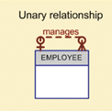
Relationship Degree
Most relationships are between two entities, but not all!
Relationship Degree indicates the number of entities associated with a relationship.
Unary (or "recursive") relationship
Association is within single entity.
E.g. EMPLOYEE manages EMPLOYEE.
Binary relationship
Two entities are associated.
Most common type of relationship.
Ternary relationship
Three entities are associated.
Higher degrees are rare and not specifically named.
E.g a relationship between 4 entities is a four-degree relationship.

Slide 19
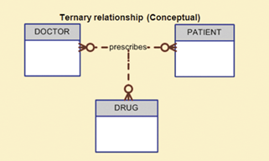
Ternary Relationship - Example
Suppose we have the following business rules:
A doctor may prescribe one or more drugs for one or more patients.
A patient may be prescribed one or more drugs by one or more doctors.
How do we model this situation?

Slide 20
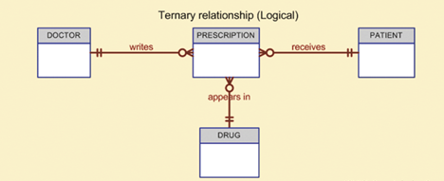
Ternary Relationship - Example
A ternary relationship can be decomposed into 3 binary relationships by introducing a composite entity.

Slide 21
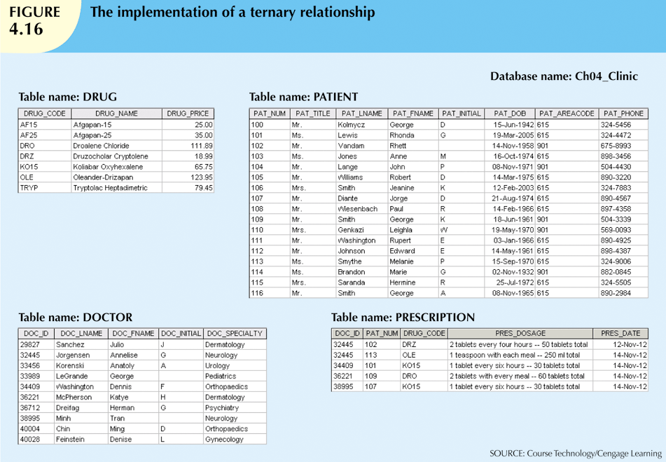
Ternary Relationship - Example

Slide 22
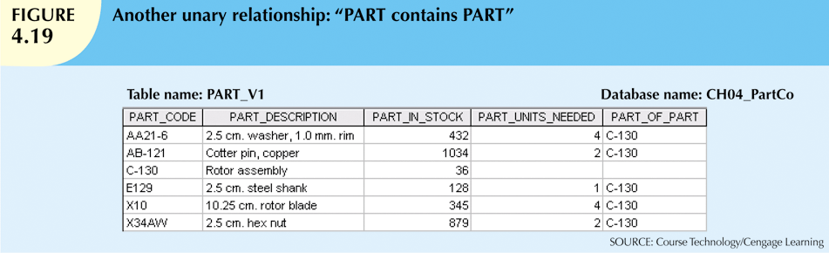
Recursive Relationships
A recursive (or unary) relationship is a relationship that exists between occurrences of the same entity set.
This is a 1:M relationship (some parts consist of other parts).

Slide 23
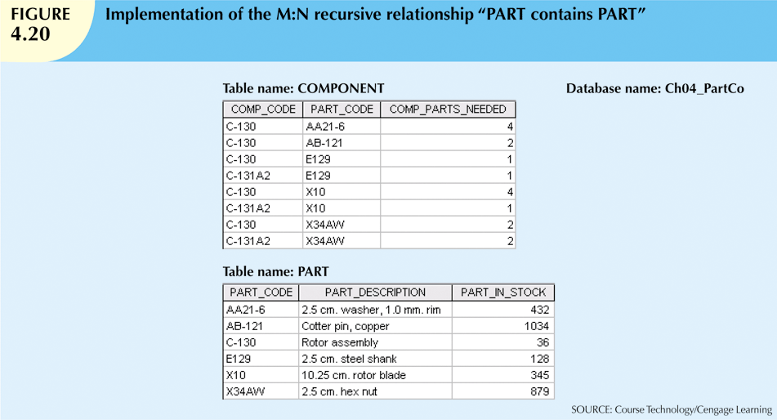
M:N Recursive Relationship Example
Suppose some parts consist of other parts, but also are part of other parts.
This creates an M:N recursive relationship.
Requires another table to be a "bridge" entity.

Slide 24
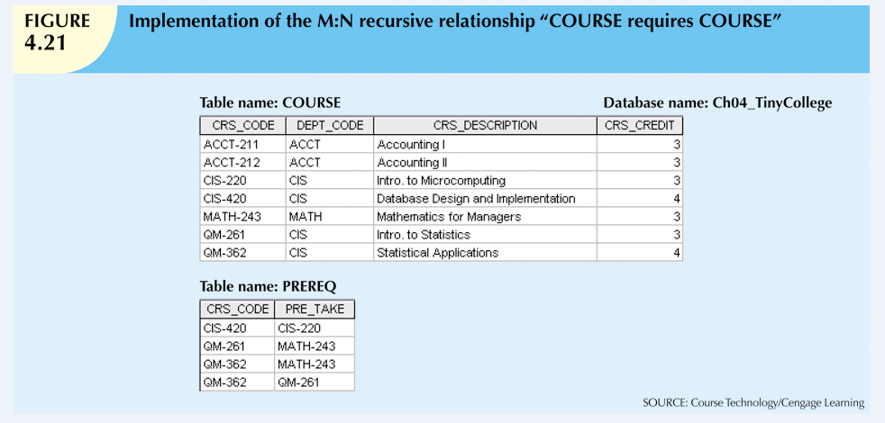
M:N Recursive Relationship Example

Slide 25
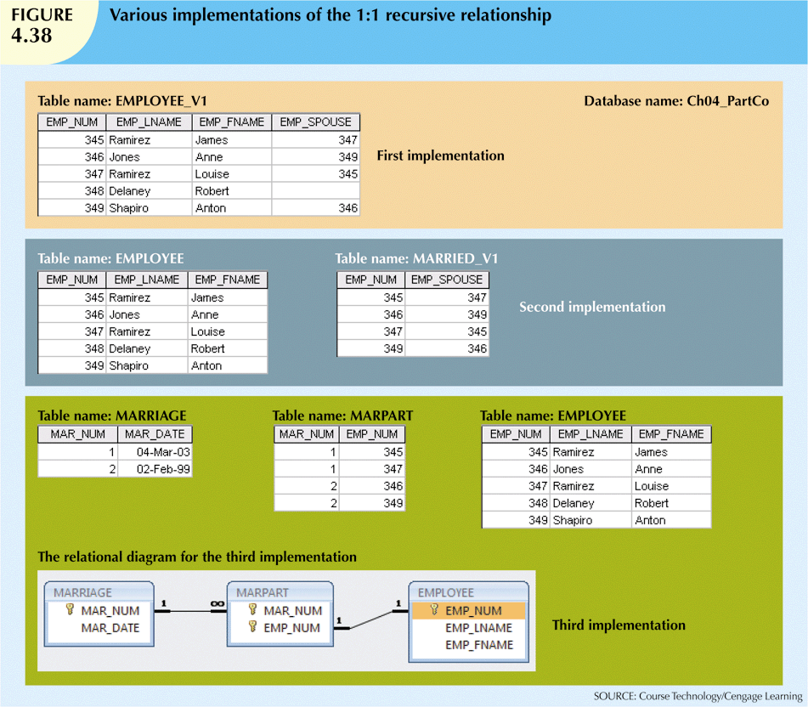
1:1 Recursive Relationship Example

